Slide 1
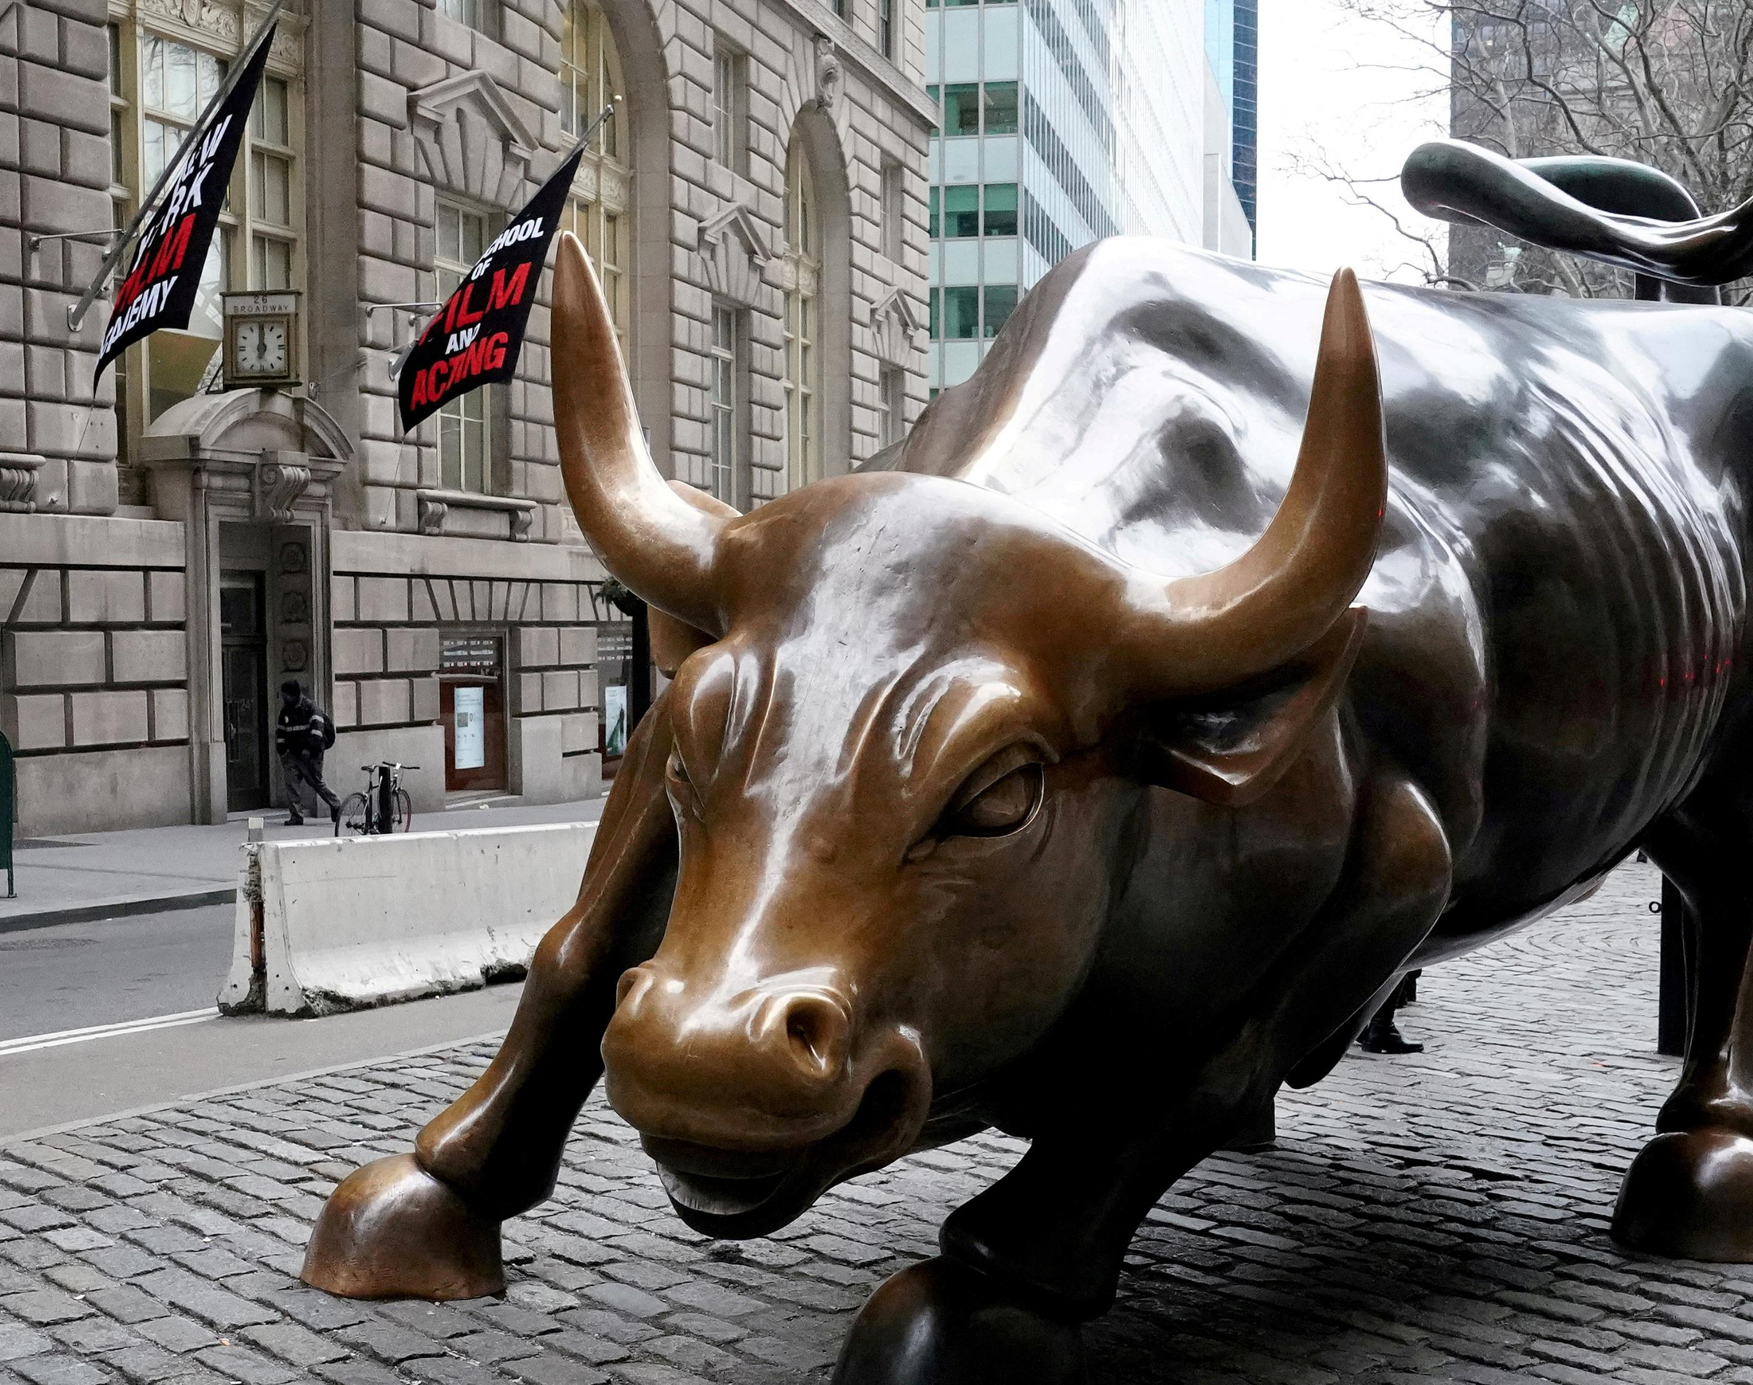
Algorithmic Trading with Machine Learning
Data Science Intensive Capstone
Matthew Miller

Slide 2
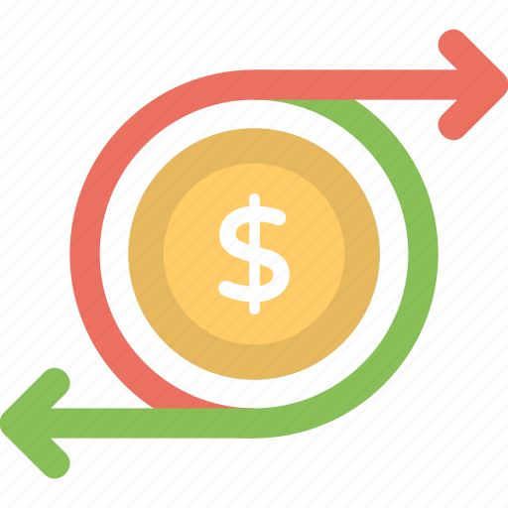
THE PROBLEM
Reliable Returns
Machine Learning Models in Finance
Efficiency in the Markets

Slide 3
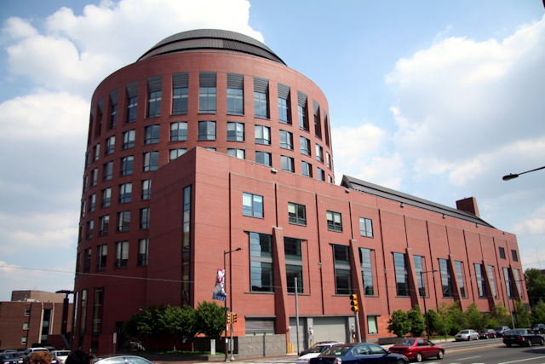
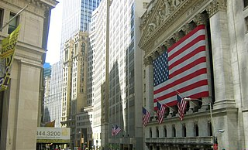
Who is Interested?
Research Institutions
Wharton School at University of Pennsylvania
MIT Sloan School
Wall St
Quant Research Firms
Algorithmic Trading Firms
Hedge Funds
Jane Street
Chicago Trading Company

Slide 4
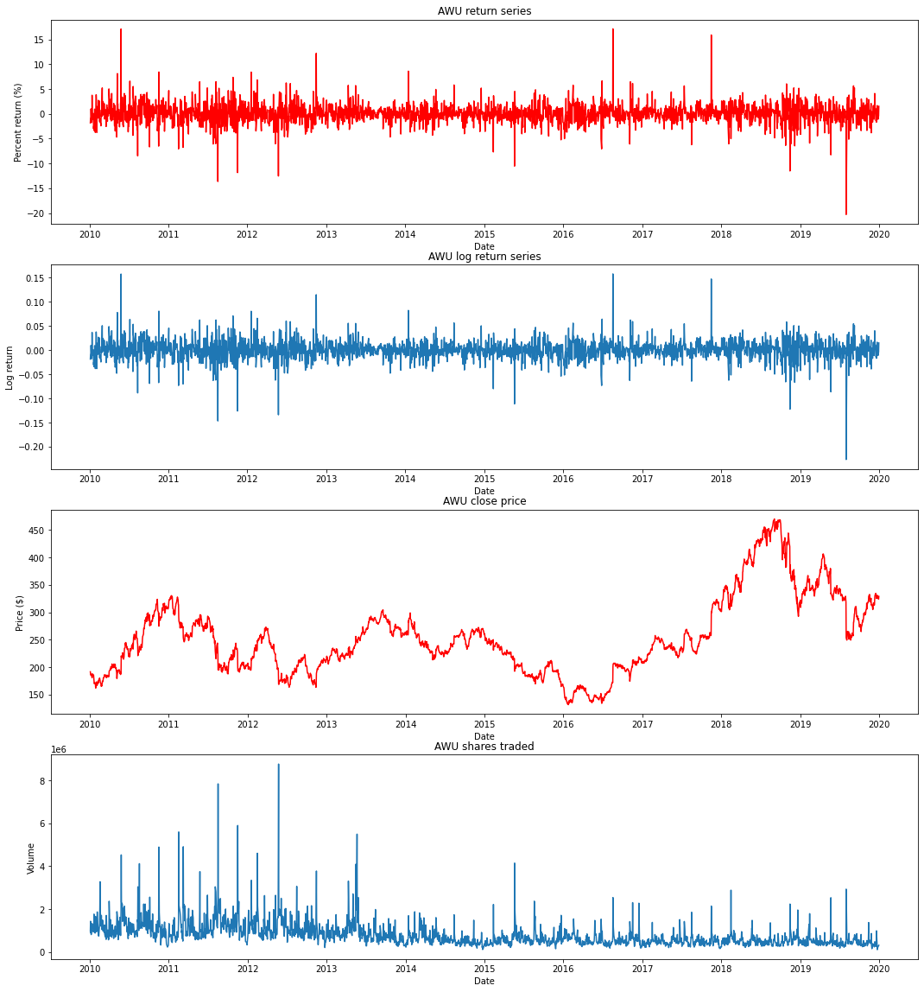
THE DATA
Notes:
Talk about the need to transform the close price data to return series
Talk about what we are hoping to identify: patterns that might determine the stocks direction the next day

Slide 5
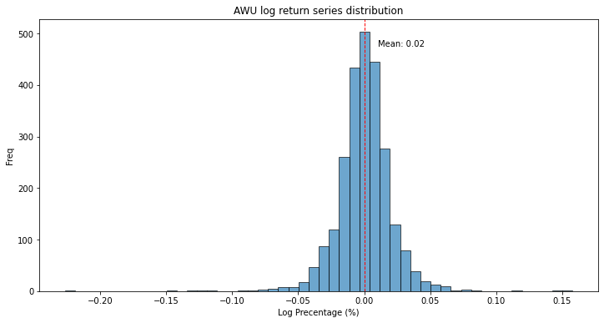
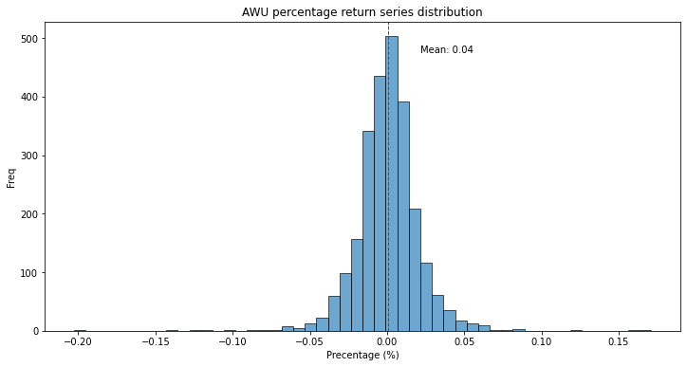
Exploring the Data – Distributions
Do the normalized return series show skew?
How might this affect the predictions?

Slide 6
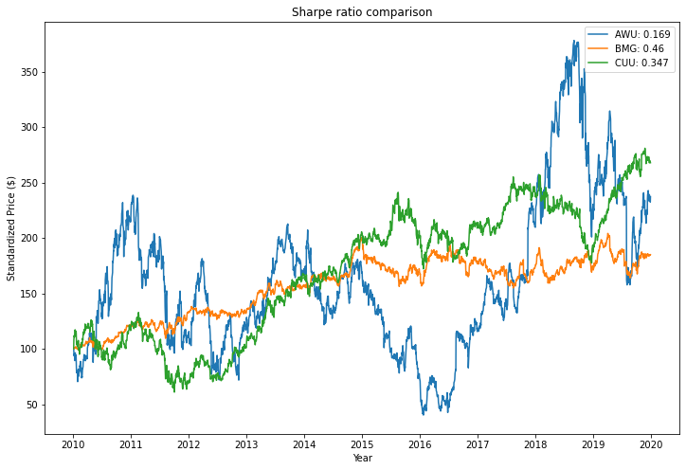
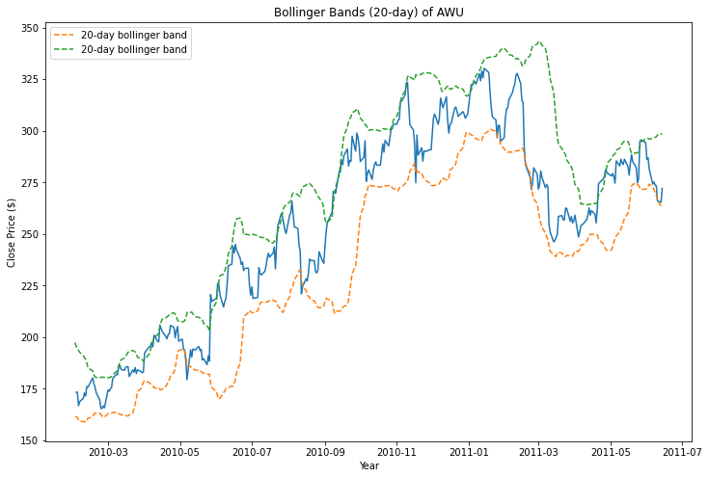
Exploring the Data – Performance Metrics & Technical Indicators
How does portfolio managers measure return vs risk?
Are moving averages and standard deviations useful in trading?

Slide 7

Machine Learning Models and Results

Slide 8
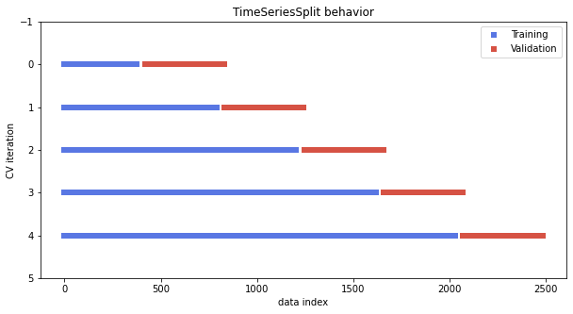
Time Series Train/Test Split

Slide 9
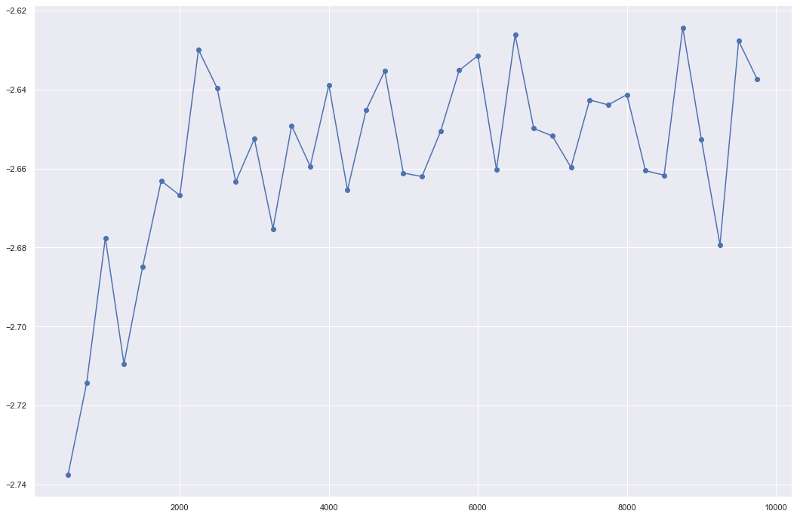
GridSearchCV
Hyperparameter tuning:
'max_depth': 5, 'max_features': 3, 'min_samples_leaf': 1089, 'n_estimators': 100
Improve accuracy without overfitting

Slide 10
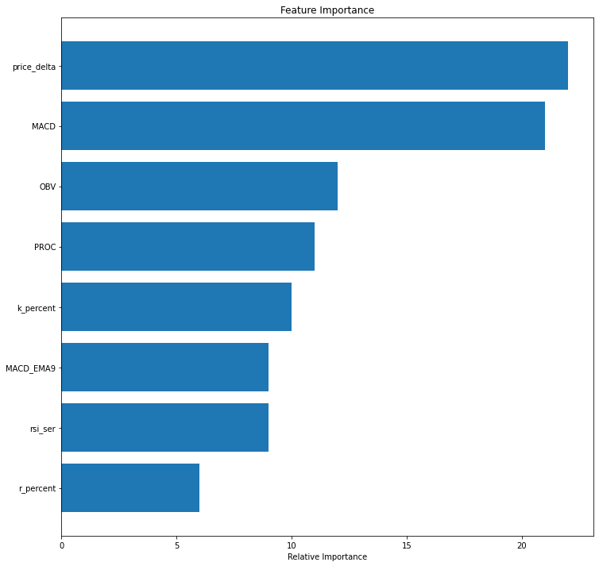
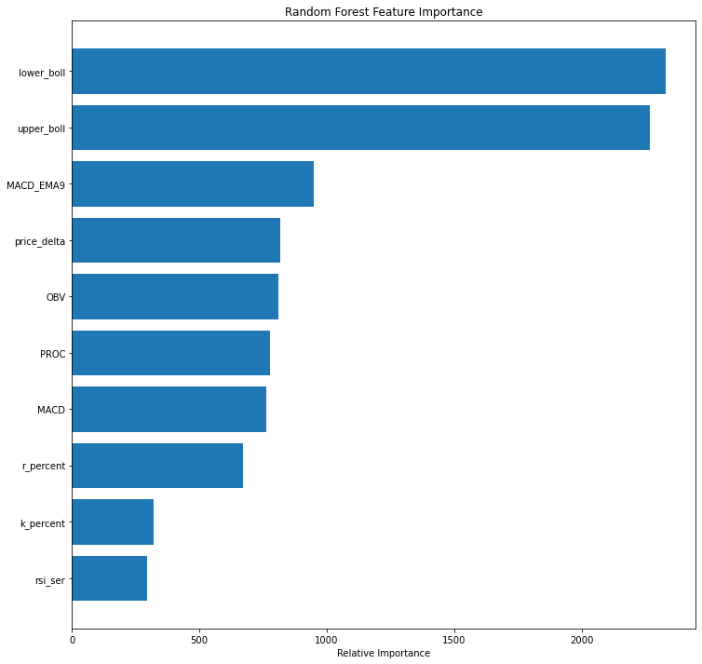
Feature Importance
Top Features:
Bollinger Bands
Price Delta
Momentum Indicators

Slide 11
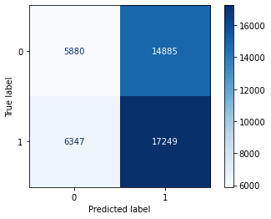
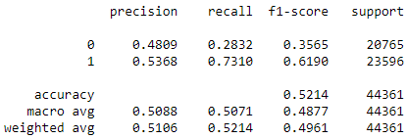
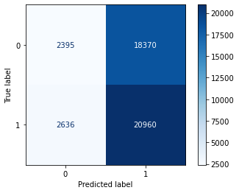
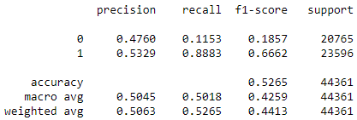
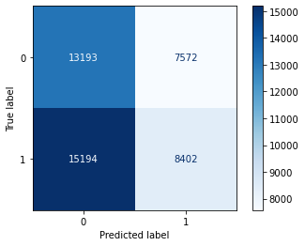
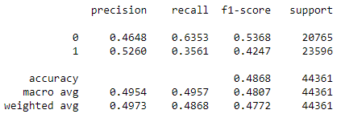
Results and Models Comparison
Best Model: Random Forest Model
Random Forest
Logistic Regression
Gaussian Naïve-Bayes

Slide 12
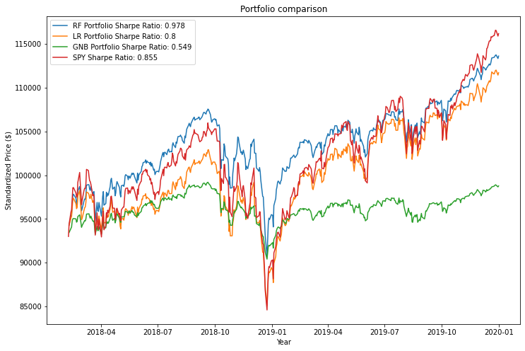
Best Model – Random Forest Regression Model
Backtest of 93 companies; $1000 each
Long hold of SPY500 resulted in overall best returns
RF Model produced the best Sharpe Ratio
Notes:
Percentage comparison with how well it performed against the SPY

Slide 13
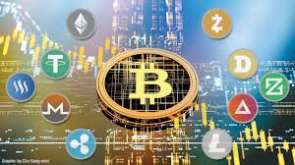

Impact
Mitigate Risks associated with long holding periods (ETFs)
Stable and Reliable Returns
Expedite efficiency in emerging markets (crypto)

Slide 14
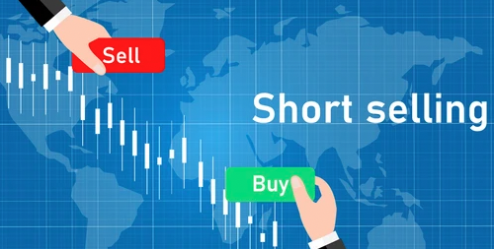
Further Explorations/Work
Research the application to emerging markets such as crypto
Integrate short selling into the execution strategy
Improve execution strategy with probability distributions
Explore correlations between industries

Slide 15
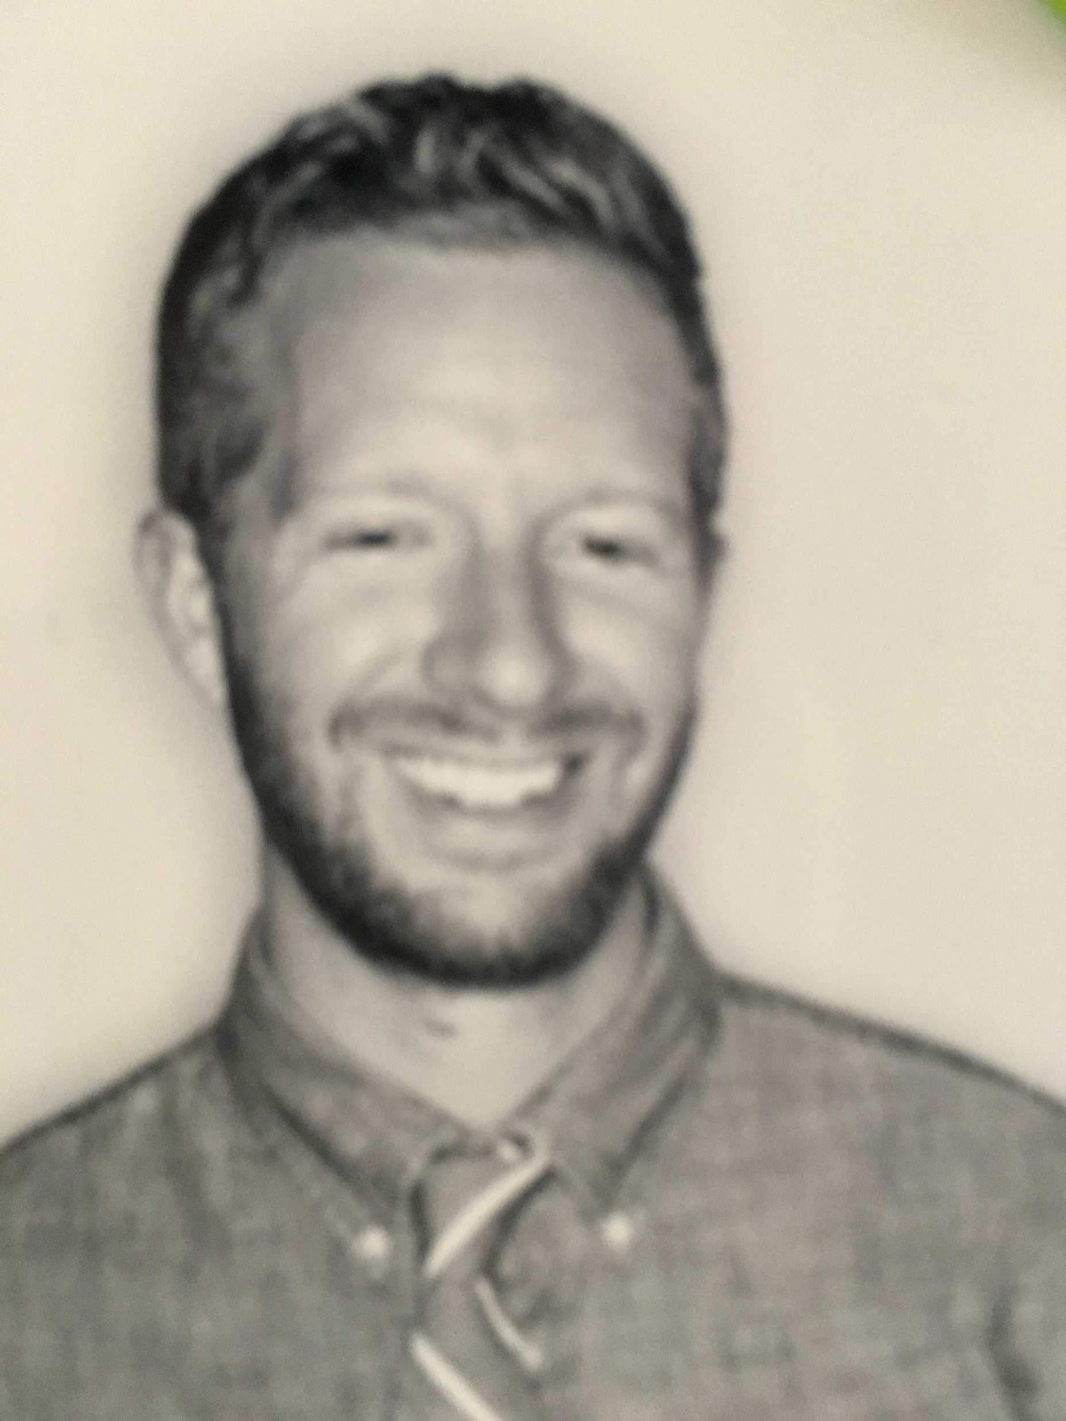
Any Questions?
Thank you, Springboard Mentor:
Blake Arensdorf, On Deck

